Slide 1
Liberian Innovation Zone Frequency Plan: Making 40 in 2021 Real
4.27.2018
Lee W McKnight, Syracuse University
Ben Wolo, Advisory Board Member Imcon International, Inc. +1 202 688 7711

Slide 2
Theory: More Internet access = more Liberian jobs, greater economic opportunities
Practice:
Investors & partners will invest in Liberian internet and energy infrastructure
International education and training partnerships
If:
Democratic political processes respected
Liberian Inter-Agency Task Force and Advisory Group facilitates
Annual Liberian Internet Forum enables multi-stakeholder dialog and coordination
LTA leads Innovation Zone authorization

Slide 3
Requested: LTA frequency operational authority assignment
Innovation Zone build-out requires many LTA authorizations, assigned as one bundle.
LTA remains free to do whatever else it wishes for incumbents and other new entrants
Anticipated: this LTA action precipitates competitive reaction and 4G+ build-out by incumbents – essential for reaching 40% Internet access in Liberia by 2021.

Slide 4
The Innovation Zone Bundle
Public Benefit Business Model
Public Private Partnerships model
Build – Transfer – Operate model
Expedited customs processing to meet Liberia’s educational needs
For 1 set of LTA license assignments and authorizations
Frequency operational authorization for multiple mainly unlicensed frequencies
Right to assign sub-licenses for operation and interconnection
Other partner agencies and ministries authorize
Right to enhance network with fiber build-outs
Authorization for Gridstreamer (cloud) and GridstreamX (edge) services
Rights of Way access
Undersea Fiber Landing Station access

Slide 5
The 40 in 2021 Operational Plan
Imcon International Foundation
(established April 218)
$$$
$$$
License
Imcon Intl Inc (III)
Provides immediate connectivity solutions including Internet Backpack
Delaware C Corp.
Imcon West Africa Corporation
Operates Education Network
Imcon Liberia Foundation
Receives right to operate on frequencies, access Rights of Way, and build towers and fiber where enhances network, for educational purposes, from LTA.
Liberian Telecommunications Authority
Assigns rights to access frequencies
Other ministries coordinate on project to:
Authorize access to Fiber Landing Station government capacity on commercial terms
Assigns Imcon Liberia LLP 20 year license right to operate
Digital Transformation Collaborative (Syracuse University) leads education network build-out
SU subcontracts Nysernet (proposed)
Builds then transfers for operation
Imcon West Africa Corporation a subsidiary
Manages network expansion with partners
Ownership: III, investors
Receives from Foundation:
20 year sublicense rights to operate frequencies, access Rights of Way, build towers and fiber, interconnect, share costs
Supports Imcon Foundations
Ownership: Investors
Can sell rights and network if/when other operator commits to educational service guarantee, and meets LLP’s price objectives
Liberian schools, ministries priority partners
To be established
To be best established
Sets policy target of free basic access for schools to justify rights allocation.
Assign right to access to Rights of Way
Authorizes right to lay fiber where it may enhance network and lower operational costs and improve performance.

Slide 6
Unlicensed and lightly licensed frequencies Requested Right for Operating Authority
151-153 MHz – GoTennna – p2p - Mesh
900 MHz – LoRa – p2p - IoT
2.4GHz – access – Wi-Fi
3.5 GHz– access/CBRS
5 GHz – access/p2p – Wi-Fi
11 GHz – p2p
24 GHz – p2p
60-80 GHz – p2p

Slide 7
Internet Backpack Networks Implemented + Planned as of 11.13.2017
Network | Frequency | Type | Functionality | Range | Bandwidth
gridstreamer | Any | User cloud | Access control for authorized Internet backpack users, text & image messaging, file & data sharing | 20 accounts | Variable
GridstreamX | Any | Open edge communication messaging | lightweight emergency/remote text messaging | 20 accounts | Scalable; confirmed to work over Thuraya from volcano
Internet | Any | IP | Connectivity | Unlimited | Unlimited
goTenna | 151-154 MHZ | MURS Multi-Use Radio Service Mesh | Text Messaging and GPS. Tethers to Smartphone | 3-5 Kilometers | 9600 bps
3G | 850/900/2100MHz | Mobile | Voice, data, text | 8-16 Kilometers | 21 Mbps
4G | 700 MHz, 1700-2100 MHz, 1900MHz and 2500-2700 MHz) | Mobile LTE | Mobile Connection, Voice, Data Text | 8-16 Kilometers | 100 Mbps
The Things Network (For smaller communities of Internet of Things) | 902.3 to 914.9 MHz uplink 923.3 MHz to 927.5 MHz downlink | LoRaWAN Mesh | IoT Information. Separate Device. Wireless Router, Repeater. | 15 Kilometers | 0.3 - 50 kbps
Thuraya (Satellite HotSpot) | 1.525 GHz to 1.559 GHz downlink 1.6265 GHz - 1.6605 GHz uplink | Satellite Internet/data/voice | Unlimited Data voice. Tethers smartphone to satellite; works for messaging with GridstreamX | 36,049 Kilometers | 16 kbps satellite 25 Mbps – 100 Mbps wifi
GPS | 1.57542 GHz 1.2276 GHz | Satellite Global location | Location Position | 36,049 Kilometers
Bluetooth | 2.4 – 2.4835 GHz | ISM (Industrial Scientific Medical) short range radio frequency | Personal Area Network. | 91 Meters | 26 Mbps
BluetoothLE | 2.4 – 2.4835 GHz | ISM (Industrial Scientific Medical) short range radio frequency Mesh | Lower Energy Variant focuses on interconnectivity of multiple devices. | 100 Meters | 1 Mbit/s
Wi-Fi | 2.4 GHz, 5 GHz | ISM Mesh | 802.11ax. Provides network connections for learning materials and course work | 70 Meters | 1 Gbit/s
Wi-Fi | 2.4 GHz, 5 GHz | ISM Central server | Provides network connections for learning materials and course work | 70 Meters | 25mbps - 1 Gbit/s
CBRS | 3.55 -3.70 GHz | Citizens Broadband Radio Service | Shared spectrum in the 3.5 GHz innovation band | 70 Meters- 16 Kilometers | 100 Mbit/s – 1 Gbit/s

Slide 8
Software as a Service with Internet backpack
Software as a Service | Number of Accounts | Key Technical Features/coding
Gridstream (proprietary) | 20 | Microsoft Azure Cloud C## PHP Active Directory RBAC IAM Skype
GridstreamX (non-proprietary) | 20 | PHP

Slide 9
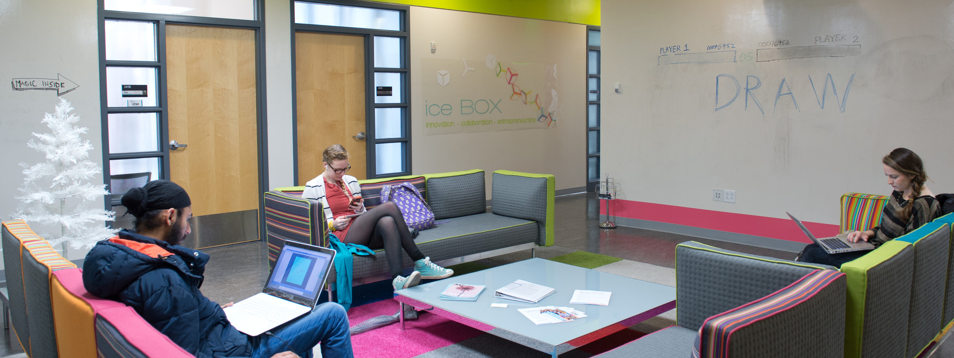
Questions? Thank You! And Go SU!* : ) *All other views expressed are not necessarily shared by Syracuse University
For more information, please contact lmcknigh@syr.edu

